Slide 1

Driver Proportions across the US kenT Roller

Slide 2

Introduction
State and federal funds are limited
Projects which maximize impact are essential
How to distinguish where these funds are distributed

Slide 3
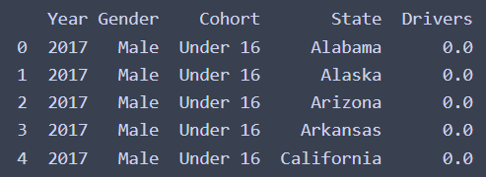
Primary dataset
The Primary dataset consist of licensed drivers listed by state.
And by drivers cohort, segmenting the drivers by age.
This data set covers the years 1994-2018.
The dataset contains 5 columns and 57834 observations

Slide 4

Secondary Datasets
There are several secondary datasets to be merged with the licensed drivers dataset:
Fuel Tax Rate by State
Amtrak Rider Number by State
Road Condition by State
Unemployment Rate by State
These secondary datasets were selected as potential datasets that when combined with the original may shed additional insight into any differences found

Slide 5

Data preprocessing

Slide 6
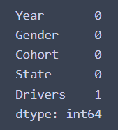
Primary Data Preprocessing
The primary dataset cleaning process was straightforward as there was only one missing value present in the original dataset, which was replaced using the mean method.

Slide 7
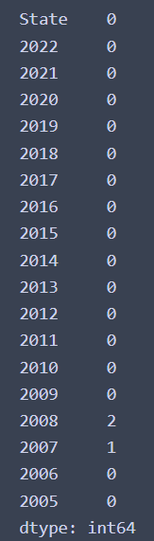
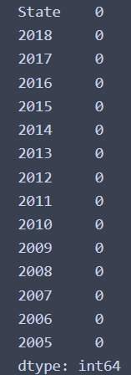
Secondary Data: Amtrak Riders
The Amtrak Riders data has both missing values and a mismatched year range when compared with licensed drivers.
We resolved this by trimming the values in the Amtrak data to match the original.
Missing values were present as well, which once again the mean method to fill Na values was used.

Slide 8
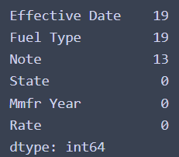
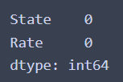
Secondary Data: Fuel Rate
The fuel rate had many missing values in several columns.
However , it was found that these columns were not needed for analysis, so we dropped the columns from the dataset.

Slide 9
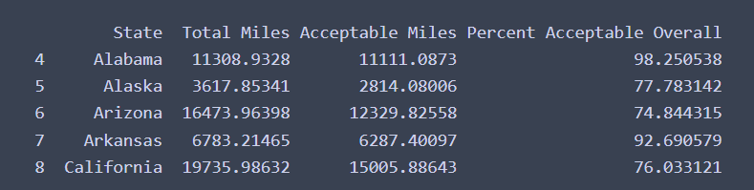
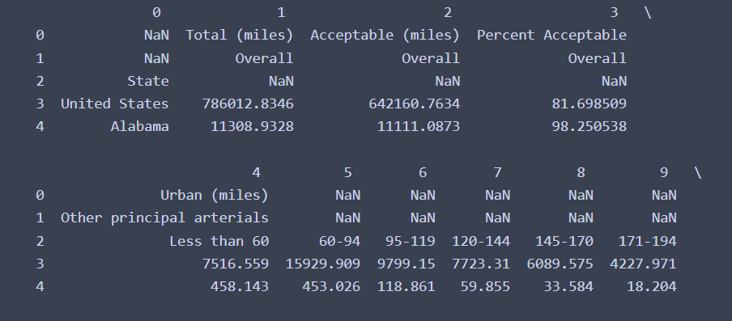
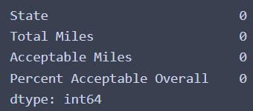
Secondary Data: Road Condition
Road Condition required additional steps to clean before use.
The Road Condition Dataset after processing

Slide 10
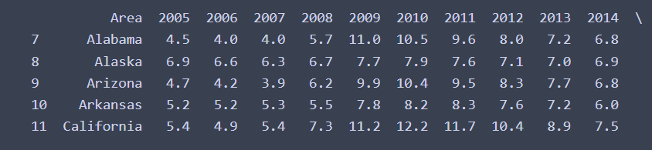
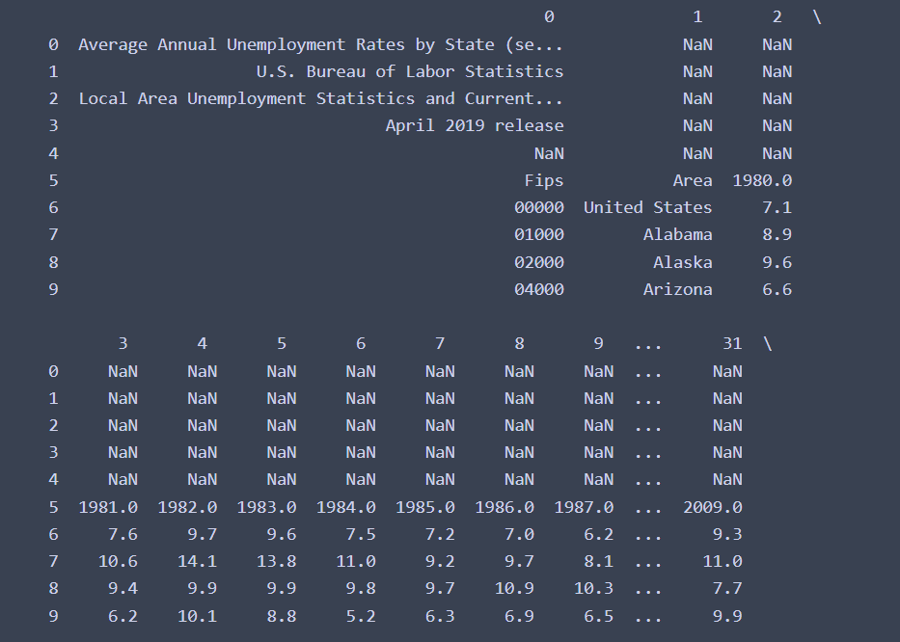
Secondary Data: Unemployment
Like the previous data set, the unemployment rate required additional work to make ready for use.
The dataset after cleaning no longer contains any of the information included in the spreadsheet or missing values

Slide 11

Merging the dATASETS

Slide 12
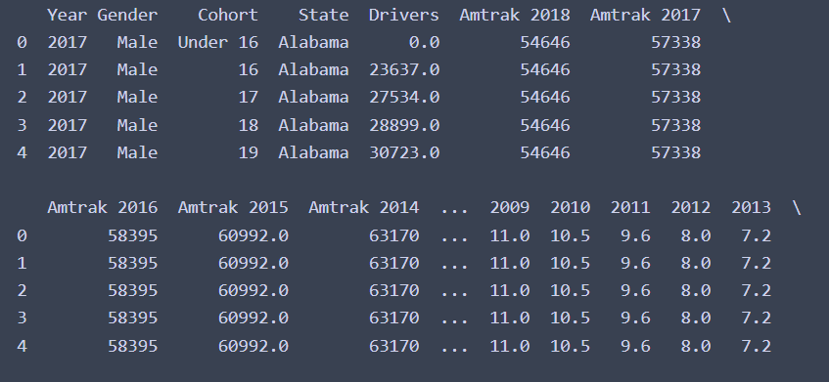
Initial Merge Attempt
Initially when trying to merge the dataset used merge on the dataset as they were and attempted to join on the column ‘State’, however this resulted in an unusable dataset.

Slide 13
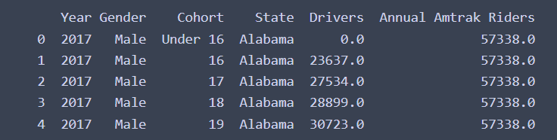
Secondary Merge
On the second attempt to merge the datasets used melt in order to reshape the data in the Amtrak data to conform to the license data which allowed for an appropriate join.

Slide 14
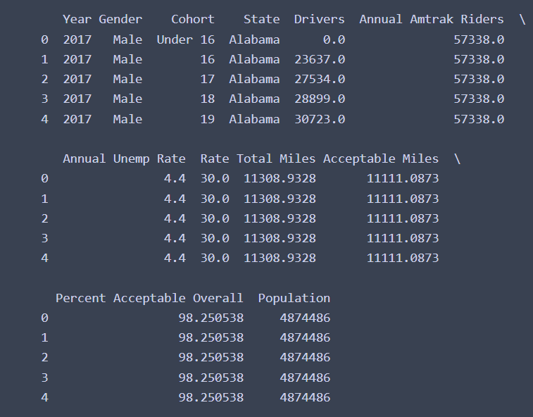
Completed Merge
The merged dataset contains the licensed data and its columns as well as the added columns from the additional dataset.
Now that the data set creation is complete, we can progress to the analysis

Slide 15

Data Analysis

Slide 16
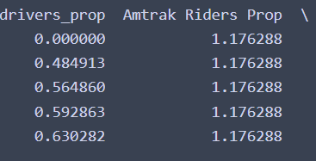
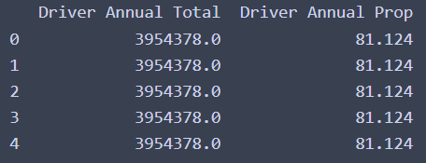
Analysis: First Step
Before Analysis can begin need to change the measure of drivers.
Instead of using a raw count we opt instead to use proportions
This same transformation is also applied to the Amtrak Riders

Slide 17
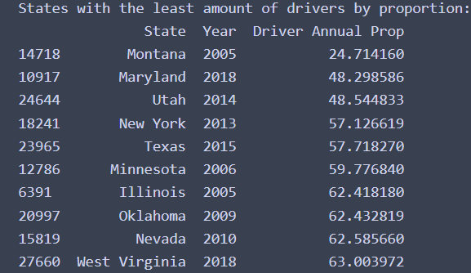
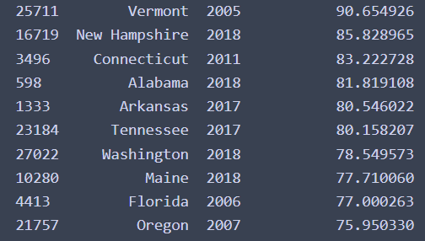
Highest and Lowest proportions of drivers
Least Amount of Drivers
Highest Amount of Drivers
Here we can see the least 10 states by driver proportion sorted from least to greatest.
And here are the 10 States with the most drivers by proportion

Slide 18
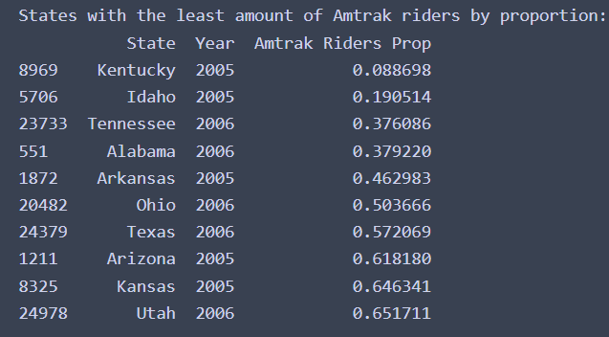
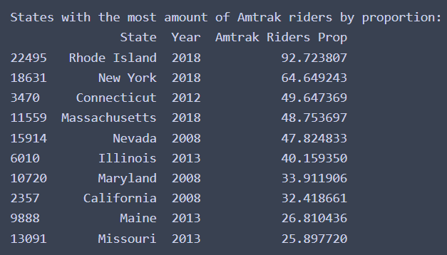
Amtrak Proportion Comparison
The same comparison can be made with the Amtrak rider proportions between the top 10 and least 10 states by rider. The least amount of Amtrak riders is shown left and the most is shown on the right.

Slide 19


How to Show a difference
Before progressing, we need to show that a difference between states exist
We cannot use a t-test as we do not know the distribution of the data
We cannot use Welch’s t-test as we do not the variance between counts
So, we use a non-parametric method, Permutations
Here the permutation p-value indicates a rejection of the hypothesis of identical probability curves for each group.

Slide 20
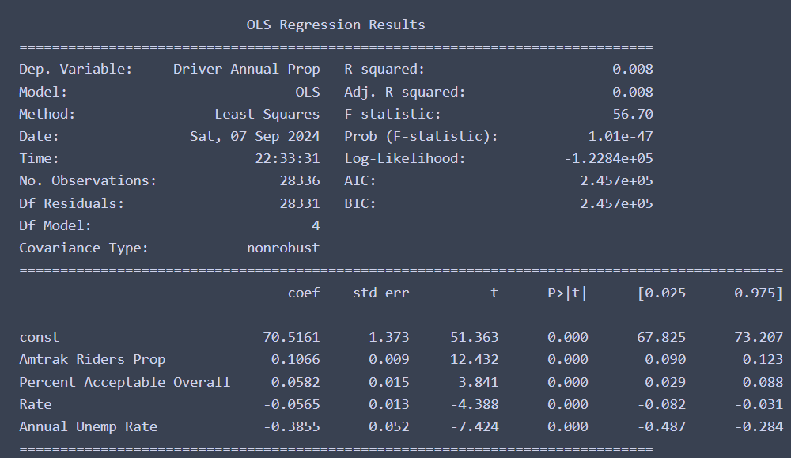
Trying to Show why the difference exist
The first attempt at showcasing why this difference exist we tried OLS regression.
Here, the proportion of drivers in each State was used as the response.
The predictors were selected as the constant, Amtrak Riders Prop, Fuel Rate, and Unemployment Rate.

Slide 21
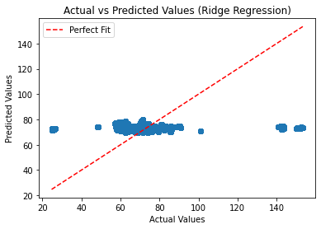

Using Ridge Regression
The performance of the OLS Regression is incredibly poor. We can instead try a different model.
Ridge regression can help resolve any mutli-collinearity between variables in the dataset.
If multi-collinearity was the issue this will help resolve it.
Unfortunately, this did not prove to be the case as can be seen in the prediction scatterplot.

Slide 22
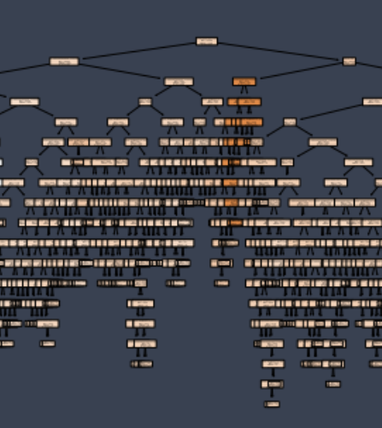
Random Forest Regressor
After the poor performance exhibited by the previous two models, a new approach is selected.
Here we use Random Forest to try and get a suitable prediction.

Slide 23
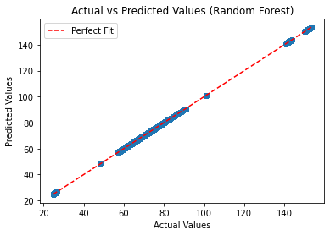
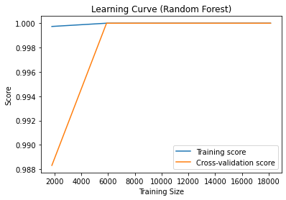
Random forest regressor II
As can be see in the scatterplot, we now have the opposite problem where the data is overfitted to the model. This can be further seen in the learning curve where the training score is a constant 1 and the cross validation score also quickly becomes 1.

Slide 24
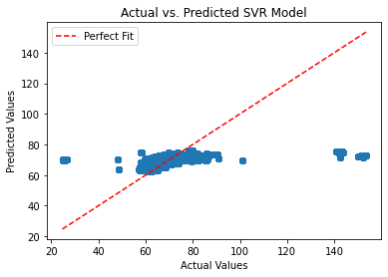

Support Vector Regression
As a last attempt, we try to use Support Vector Regression, which is built off of the SVM package.
Unfortunately, the performance gained by switching to this method was minimal over the others, once again yielding a poor r2 value.

Slide 25

Conclusion

Slide 26

Conclusion
Here we managed to take multiple datasets, clean them, and merge them
We were able to take the data and show that a significant difference existed between the proportions of drivers between states.
However, we were unable to gain any insight into why this difference may exist
Additional predictors would be needed to establish a cause for this difference
Additional exploration of the distribution of the data could be performed to find better models.

Slide 27

THANK YOU
Kent Roller
kdroller@syr.edu

